Slide 1
CEIS101 Final Project
Circuit Simulation in Tinkercad
CEIS101C July 2022
Christopher Hill
Professor D’Souza

Slide 2
Planning The Project
We used Tinkercad to design the initial project
We discussed the breadboard
We used the Arduino controller in this development environment

Slide 3
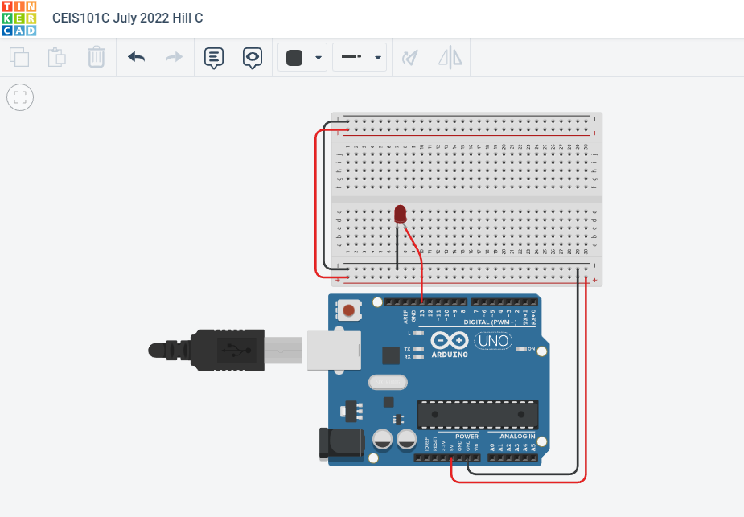
Circuit Design

Slide 4
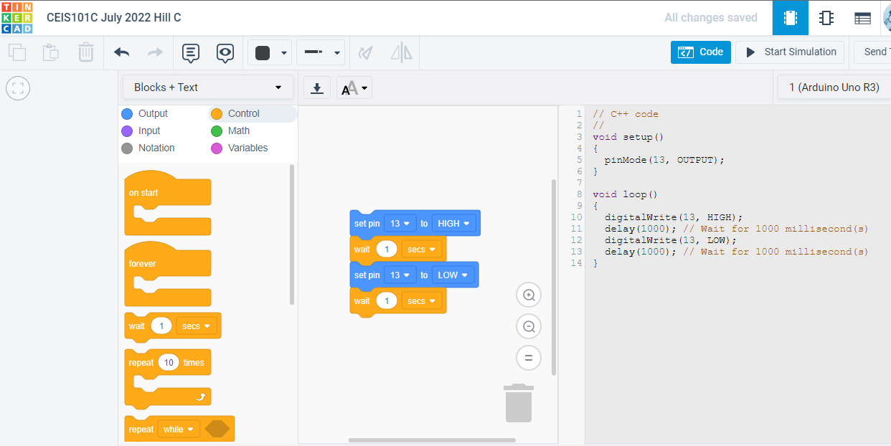
Code for IoT

Slide 5
Initial IoT Project using Arduino
Hands-on development of IoT project
Used Arduino Mega controller
Used breadboard

Slide 6
Circuit with red LED on

Slide 7
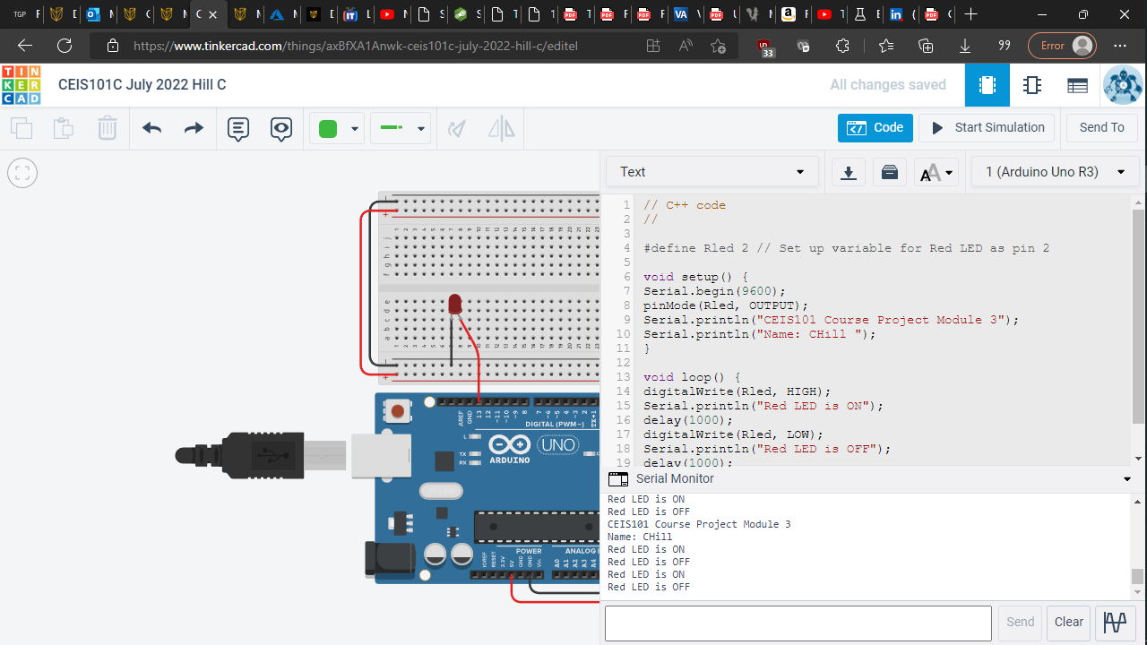
Serial Monitor

Slide 8
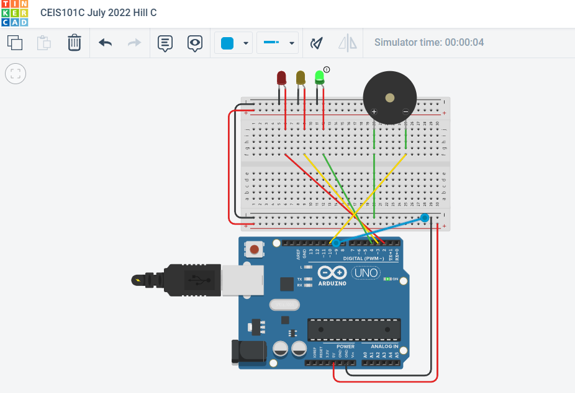
Circuit of door closed with Green LED on

Slide 9
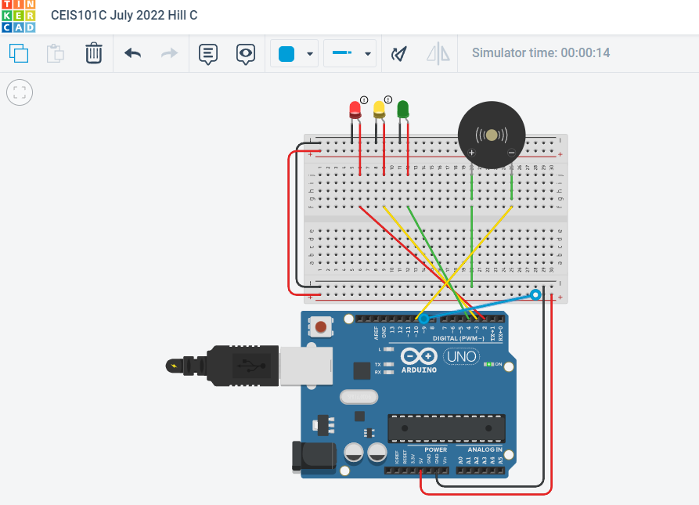
Circuit of door open with Green LED off

Slide 10
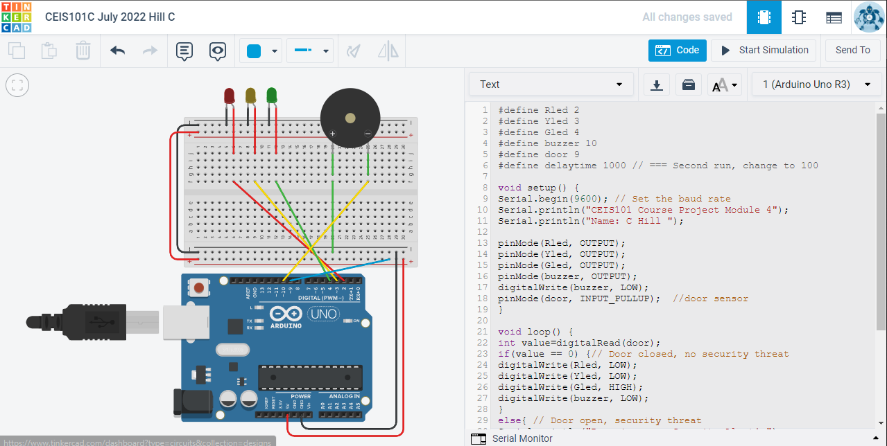
Arduino Code

Slide 11
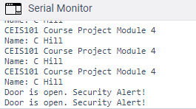
Serial Monitor

Slide 12
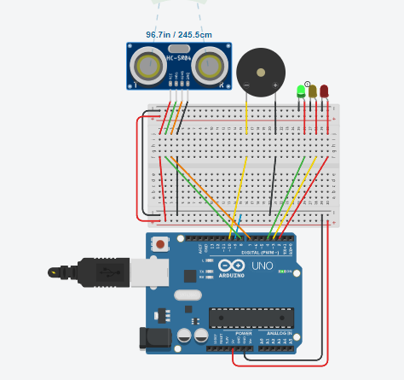
Circuit with green LED on

Slide 13
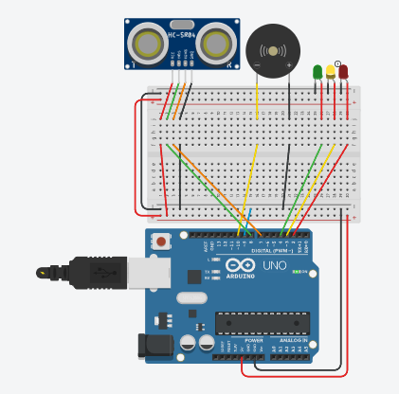
Circuit with yellow LED on

Slide 14
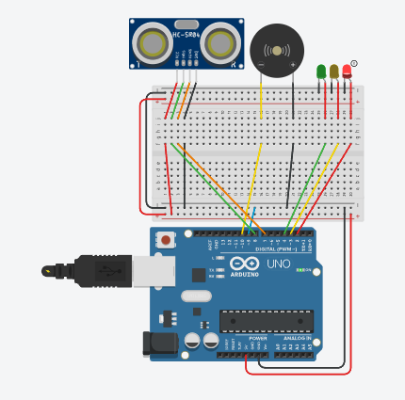
Circuit with red LED on

Slide 15
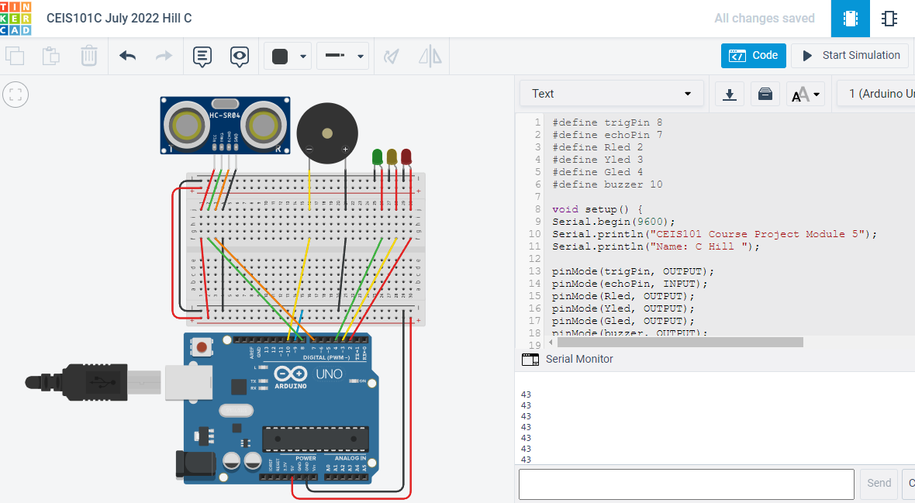
Arduino Code

Slide 16
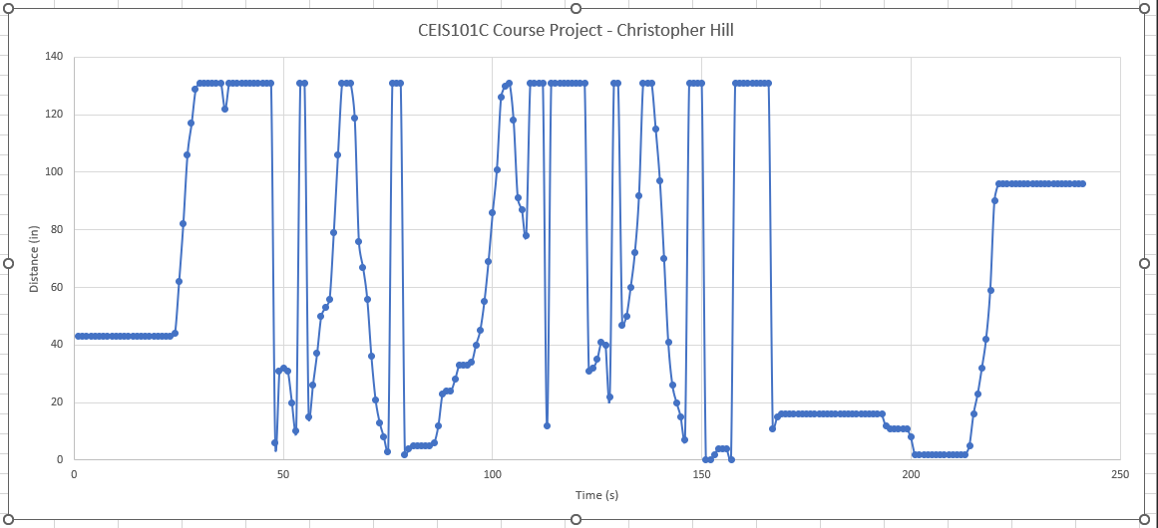
Plot of data

Slide 17
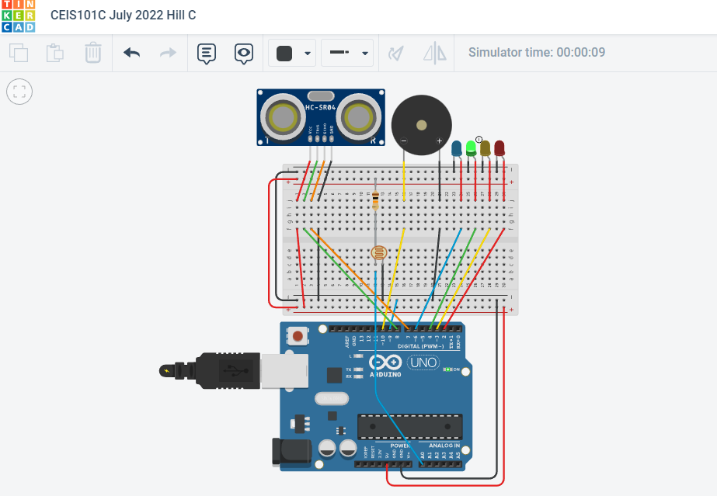
Circuit with automated LED off

Slide 18
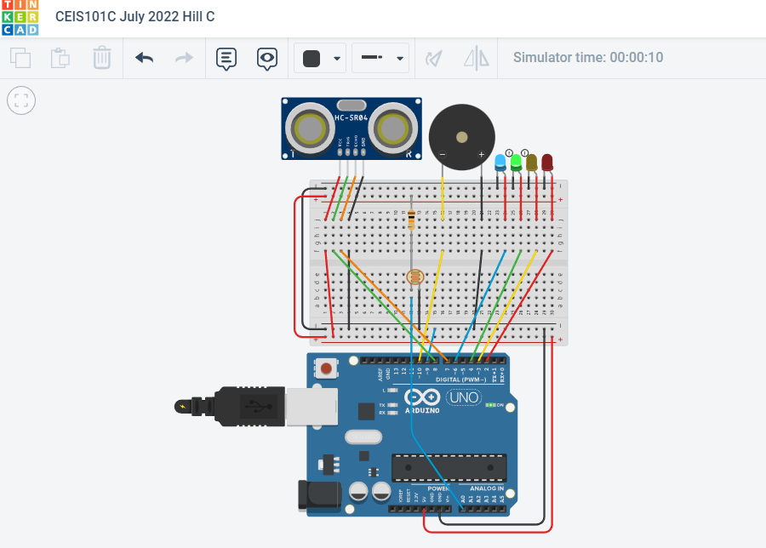
Circuit with automated LED on

Slide 19
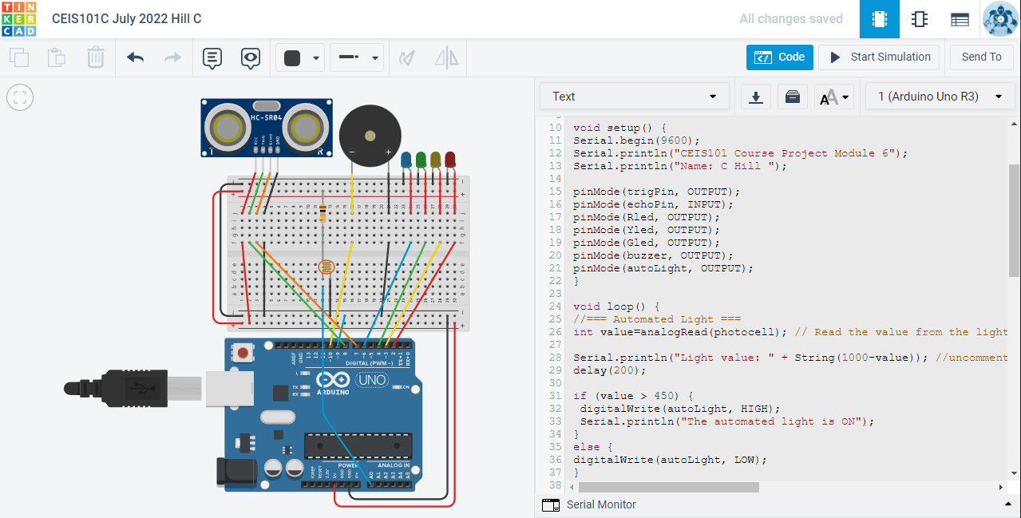
Arduino Code

Slide 20
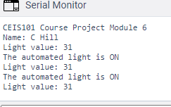
Serial Monitor
I added ‘Serial.println("Light value: " + String(1000-value));’ to the code because I was curious to see the light value on the serial monitor.

Slide 21
Challenges
I had to search on Stackexchange for the extra code I added for testing: ‘Serial.println("Light value: " + String(1000-value));’

Slide 22
Conclusion
This was a great introduction to Arduino and its coding environment
Tinkercad is an invaluable tool for designing a circuit for free
Schematics created online are much simpler than physical parts
Coding within Tinkercad is faster than uploading to physicals

